Slide 1
Physics Lesson Plan
Explore Momentum and Impact Force in an Egg Drop
Block 1/28-29/2015
Notes:
Objective: Students will be able to…
Explore and explain 3 methods for reducing the impact force applied to an object
Assessment: By…
Articulate the 3 ways to reduce impact force
Evaluate a scenario to determine the scientific rationale for how it reduces impact force
Verbally describe if an object is “reducing impact velocity” “increasing impact time” “increasing impact area”
Criteria for Success:
Articulate the 3 ways to reduce impact force
Evaluate a scenario to determine the scientific rationale for how it reduces impact force
Verbally describe if an object is “reducing impact velocity” “increasing impact time” “increasing impact area”
Key Points:
KP1: Impact force is minimized by decreasing velocity
KP2: Impact force is minimized by increasing total time of impact
KP3: Impact force is minimized by increasing total area of impact
Key Terms/Vocabulary:
Impact Force
Pressure
Potential Student Misunderstandings:

Slide 2
Front of the Room 2nd
Elyjah | Candy
Imani | Tajhion
Derianka | Kanhaya
Justyn | Laniya | Keishaun
Gabriel | Aliyah | Jason
Lashawn | Christina
Ricardo | Wuraola
Eric | Chanice
Welcome! Please enter silently. Once you have followed the instructions, begin your Do Now Quiz
Take out your planner and write the prepwork
Take out your homework
Hang your backpack on the back of your chair.
Notes:
SEATING CHART:

Slide 3
Front of the Room 3rd
Garrick | Adonis
Zeek | Keniesha
Destiny | Carol
Shantel | Keontae
Keyshawna | Ayiana |  | Briana
Yanaja | Ameer |  | Donta
Tyrik | Dalia |  | Ciarah
Ariana |  | Ruben
Genorie | Jayvon S
Asiyannie | Khadijah
Rori | Jayden
Steven | Jasmine
Welcome! Please enter silently. Once you have followed the instructions, begin your Do Now Quiz
Take out your planner and write the prepwork
Take out your homework
Hang your backpack on the back of your chair.
Notes:
SEATING CHART

Slide 4
Front of the Room 6th
Victoria | Jaebez
Monita | Kayshawn
Shakeena | Ashley
Nasir | Jamella | Lloyd
Joshua | Gigi | Jeanell
Martin
Welcome! Please enter silently. Once you have followed the instructions, begin your Do Now Quiz
Take out your planner and write the prepwork
Take out your homework
Hang your backpack on the back of your chair.
Notes:
SEATING CHART

Slide 5
Front of the Room 7th
Anabel | Dajah
Zubaida | Rakim
Cordell | Samira
Amanda | Jayvon | Wendell
Reynaldo | Jayden | Hannah
Destiny | Shiniece | Harry
Chris | Elijah
Josh | Barry
D'Avian
Welcome! Please enter silently. Once you have followed the instructions, begin your Do Now Quiz
Take out your planner and write the prepwork
Take out your homework
Hang your backpack on the back of your chair.
Notes:
SEATING CHART

Slide 6
DO NOW BLOCK 1/28-29
Notes:
Do Now Quiz (7 minutes. 8:00, 9:26 9:26, 12:42) Momentum Formula:
1 min: Students enter silently and take out materials for class
Give recs to students who successfully get materials quickly
6 min: Students begin working on the Do Now
Circulate to make sure students have settled with materials out
Students are:
Writing Do Now
Aggressive Monitoring:
Materials are out
Students are completing do now
CFU’s:

Slide 7
Physics Desk Set-Up
Pen/Pencil
Planner
Folder
Notebook
Binder
Under seat:
Notes:
Desk Setup (1 minutes. 8:07, 9:26 9:26, 12:42) :
Instruct students to pass forward their Do Now then organize their desks as directed.
Instruct students to write PW if not yet completed.
Instruct students to pass forward their PW from the previous night
Students are:
Silently passing forward Do Now and organizing their space, then passing forward PW

Slide 8
AGENDA
Objective: Explore and explain methods for reducing the impact force applied to a moving object
7mins: Do Now Quiz
8mins: Content Intro- Impact Force
30mins: Exploring Impact Force
20mins: Discussion and Explanations
15mins: Practice
Notes:
Agenda (2 minutes. 8:08, 9:27, 12:43) Egg Drop:
Frame the lesson: Today we are moving abck into the lab, to get to do an activity.
While I think this activity is pretty fun, the reason I’m doing it is because there is something really important to learn. As we move through the day, it is important to remember that we have a purpose in doing this, more than “have fun” or “be creative.” A purpose that relates to our conversations on Monday about Momentum. Lets take a look!
Students are:
Tracking, listening, no active task

Slide 9
Egg Drop Strategy
When the direction is given, we will move silently to the lab.
As you enter, take a seat at your lab station, and begin reading the directions, then writing the “initial strategy” section on your handout.
Notes:
Content Overview (5 minutes. 8:10, 9:29, 12:45) Egg Drop:
3 mins: Call on students to read the mission and purpose.
Review that the idea is to reduce the Impact Force on the egg. In order to do this, we need a strategy. There are 3 strategies to reduce impact force, and I am looking to give raptor recs to groups that work efficiently and can identify all 3 strategies
2: As we transition to the lab, take your paper with you and a pencil. When you arrive, sit down silently and begin writing your initial strategy.
Students are:
Following along on handout, reading, transitioning, silently writing

Slide 10
Egg Drop Strategy
2 mins: Once you receive your egg drop materials, take two minutes to discuss your strategy with your group members, and decide on a plan
Notes:
Guided Practice (6 minutes. 8:15, 9:34, 12:50) Egg Drop:
4 min: Silently writing initial strategy,
2 mins: discussing with group to develop a strategy
Pass out materials but do not touch until after groups discuss strategy
Students are:
Silently writing then discussing
PR/TR Questioning:
Is this car driving on the highway, or down the street? How do you know? (street, ex: 35mph is the limit on flatlands)
What is the first step in our process? (write problem as a fraction)
How do I do this? (34 miles on top, 1 hour on bottom, not the whole thing over 1)
In this problem, which units need to be converted? (mi and hr)
Step 2: Are there CF ready to do this? (yes)
Step 3: If I want to convert mi into ft, how should I set up my CF (5280 ft on top, 1mi on bottom)
Why (so everything cancels)
If I want to convert hr to min, how should I set up my CF (1 hr on top, 60min on bottom)
Why (so everything cancels)
Lets make sure we’ve done this correctly, and cancel some units to check. Does everything cancel? (yes)
What unit will we be left with? (ft/min)
Step 4: How do I multiply this out? (whole top, whole bottom)

Slide 11
Egg Drop Container Build
15 mins: Work with your group to build a container according to the strategy you have discussed
Notes:
Guided Practice (18 minutes. 8:21, 9:40, 12:56) Egg Drop Build Time:
3 min: Remind students of parameters
15 mins: Build Time
Students are:
Discussing and building their containers
Aggressively Monitoring For:
Students have developed a strategy and can stamp it (soft, slow, secure)
Students are placing materials purposefully according to their stated strategy

Slide 12
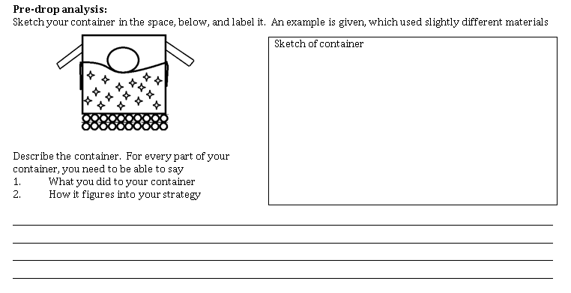
Egg Drop Justification
2 mins: Draw a sketch of your container, and label the materials
3 mins: Write a description of how each of the materials you used relates back to your strategy, justify why it was part of your design.
2 mins:
Draw and Label
3 mins:
Describe each part
Notes:
Independent Practice (6 minutes. 8:39, 9:58, 1:14) Egg Drop Description :
2 mins: Draw and Label Diagram
3 mins: Describe each material and explain its purpose
Students are:
Writing and answering questions
PR/TR Questioning:
What am I looking for in this problem? (momentum)
Why can’t I just do 190ft/s * 3593lbs? (the units would be different, so we couldn’t actually compare)
What value do I get when I do that? (682670 lbft/sec)
How do I write this as a fraction?
Now lets chunk this out, which parts need to be converted? (Lbs-kg, ft-m)
Do we have CFs for each? (yes)
How do we line up these conversion factors, does it matter which one goes first? (No)
Does it matter which value is on top? (yes)
Why? (so that the units cancel)
Based on the math, who has more momentum? (the blue whale, we don’t even come close!)

Slide 13
Egg Drop!
Eggs are dropped from a height of 3 m, inside the classroom.
When it is your group’s turn, 1 member gets 30 seconds to introduce the strategy and say how the design follows the strategy
Egg is dropped, but no eggs are checked until every group has dropped.
If your egg survives, I will collect successful containers and we can complete a final drop after school for anyone interested
Notes:
Whole Class (15 minutes. 8:45, 10:04, 1:20) Egg Drop!:
5 mins: Discuss and give raptor recs to the students who identify the 3 strategies, and flush out each one
5 mins: Drop and check your egg
5 mins: Cleanup and return to class
Students are:
Working silently/independently, raising hands with questions
Aggressive Monitoring:
Correctly written problem as a top to bottom fraction.
Correctly identified which CFs to use
Correctly set up CFs with the right value on top/bottom
Units cancel
Multiplication/division makes sense
Answer is correct with proper unit
CFU’s:
Questioning during independent practice based on specifics of are they following our unit conversions process

Slide 14
Egg Drop Reflections
If your egg is still unbroken, and would like to compete after school, bring your container back to the classroom.
Otherwise, clean up your work space and to move silently back to 305
As you silently return to the classroom, find your seat and start writing the reflection.
Notes:
Continued from previous slide

Slide 15
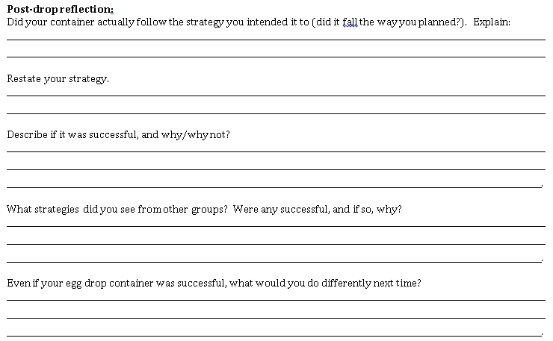
Notes:
Independent Practice (5 minutes. 9:00, 10:19, 1:35) Egg Drop Reflection
Students Complete reflection

Slide 16
Intro to Momentum
Dir: NB’s out. Silently taking notes. Questions at the end of the slide.
1/28/15
How to Reduce Impact Force
Strategies for protecting an egg:
1.
2.
3.
Notes:
Notes and Demos (5 minutes. 9:05, 10:24, 1:40) How to Reduce Impact Force:
Re-stamp the 3 strategies and label them
Slow- reduce velocity
Soft- increase the total impact time
Secure- increase the area of impact
Students are:
Writing and listening

Slide 17
Intro to Momentum
Dir: NB’s out. Silently taking notes. Questions at the end of the slide.
Reducing Velocity:
Slower moving objects will result in smaller change in velocity when brought to a stop
Smaller change in velocity means lower impact force
Write 3+ ways Curiosity reduces its landing velocity
https://www.youtube.com/watch?v=a4YqNoLkmxE
Notes:
Notes and Demos (3 minutes. 9:10, 10:29, 1:45) How to Reduce Impact Force:
Re-stamp the 3 strategies and label them
Slow- reduce velocity
Soft- increase the total impact time
Secure- increase the area of impact
Students are:
Writing and listening

Slide 18
Intro to Momentum
Dir: NB’s out. Silently taking notes. Questions at the end of the slide.
Increasing Time:
Higher time of impact means the change in velocity takes longer
Reducing acceleration means lower impact force
Write 3+ ways Volvo increases time of impact in crashes:
http://www.youtube.com/watch?v=zS_Gk7vjmOg
Notes:
Notes and Demos (3 minutes. 9:13, 10:32, 1:48) How to Reduce Impact Force:
Re-stamp the 3 strategies and label them
Slow- reduce velocity
Soft- increase the total impact time
Secure- increase the area of impact
Students are:
Writing and listening

Slide 19
Intro to Momentum
Dir: NB’s out. Silently taking notes. Questions at the end of the slide.
Decreasing Pressure:
Spreading out the impact zone means that the same total force is applied over a larger area
Less force is applied to any one spot
Notes:
Notes and Demos (3 minutes. 9:16, 10:35, 1:51) How to Reduce Impact Force:
Re-stamp the 3 strategies and label them
Slow- reduce velocity
Soft- increase the total impact time
Secure- increase the area of impact
Students are:
Writing and listening

Slide 20
CLOSING
Clean Up Time:
Binders should be pizza’ed under desks
Area should be free from trash paper
File papers as given below:
Begin working on the exit slip
Handout Title | Location
PW Bookwork Written | Planner
Notes:
Closing and Cleanup (2 mins. 9:42, 10:38 2:14, 3:10) p=mv:
2 mins: Binders are put away and floor is cleaned up, PW is filed in red folder, desks are moved back to correct locations
Students are:
Cleaning/organizing

Slide 21
EXIT SLIP
5 mins: Complete the exit slip on the page provided
Notes:
Exit Slip (5 mins. 9:44, 10:40 2:16, 3:12) p=mv:
5 min: Students silently complete exit slip
Students are:
Writing
Aggressive Monitoring:
Score exit slips as they work and as they are leaving

