Slide 1
Physics Lesson Plan
Explore Gravitational Acceleration with F=ma
Tues 2/3/2015
To Do: Clean up Classroom
Make Activity Bins with 5 materials, SS, balance, ring stand
Notes:
Objective: Students will be able to…
calculate acceleration from gravity as 10m/s2 (9.8) and explain that this acceleration applies to all objects on earth regardless of mass or state of motion
Assessment: By…
Giving the gravitational acceleration of a 2.8kg brick
Finding the mass for a 1.3N wood block
Criteria for Success:
Explain gravitational acceleration as 9.8m/s2
Describe the relationship between an object’s mass and its gravitational force
Key Points:
KP1: acceleration can be calculated as a=F/m
KP2: on Earth, every object’s gravitational force and mass will always equate to 9.8m/s² regardless of mass or state of motion
Key Terms/Vocabulary:
Gravitational acceleration
Gravitational force
Mass Velocity Force
Potential Student Misunderstandings:
Students may struggle with recognizing the difference between gravitational force and gravitational acceleration- reinforce that Fg is changing, while acceleration is staying the same.
Students may struggle with the idea that there is acceleration calculable while the object is at rest- ask students if Fg is the only force acting (no, tension is pulling opposite). Since the net force on the object is still 0, the object has no acceleration
Students may struggle with incorrect measurements- remind students how to collect more accurate data w/ the spring scales, and also discuss when the measurements are most inaccurate (lighter objects because if we mess up even a little with a light object, it throws the calculations off)

Slide 2
Front of the Room 2nd
Elyjah | Candy
Imani | Tajhion
Derianka | Kanhaya
Justyn | Laniya | Keishaun
Gabriel | Aliyah | Jason
Lashawn | Christina
Ricardo | Wuraola
Eric | Chanice
Welcome! Please enter silently. Once you have followed the instructions, begin your Do Now Quiz
Take out your planner and write the prepwork
Take out your homework
Hang your backpack on the back of your chair.
Notes:
SEATING CHART:

Slide 3
Front of the Room 3rd
Garrick | Adonis
Zeek | Keniesha
Destiny | Carol
Shantel | Keontae
Keyshawna | Ayiana |  | Briana
Yanaja | Ameer |  | Donta
Tyrik | Dalia |  | Ciarah
Ariana |  | Ruben
Genorie | Jayvon S
Asiyannie | Khadijah
Rori | Jayden
Steven | Jasmine
Welcome! Please enter silently. Once you have followed the instructions, begin your Do Now Quiz
Take out your planner and write the prepwork
Take out your homework
Hang your backpack on the back of your chair.
Notes:
SEATING CHART

Slide 4
Front of the Room 6th
Victoria | Jaebez
Monita | Kayshawn
Shakeena | Ashley
Nasir | Jamella | Lloyd
Joshua | Gigi | Jeanell
Martin
Welcome! Please enter silently. Once you have followed the instructions, begin your Do Now Quiz
Take out your planner and write the prepwork
Take out your homework
Hang your backpack on the back of your chair.
Notes:
SEATING CHART

Slide 5
Front of the Room 7th
Anabel | Dajah
Zubaida | Rakim
Cordell | Samira
Amanda | Jayvon | Wendell
Reynaldo | Jayden | Hannah
Destiny | Shiniece | Harry
Chris | Elijah
Josh | Barry
D'Avian
Welcome! Please enter silently. Once you have followed the instructions, begin your Do Now Quiz
Take out your planner and write the prepwork
Take out your homework
Hang your backpack on the back of your chair.
Notes:
SEATING CHART

Slide 6
DO NOW TUESDAY 1/27
Notes:
Do Now Completion (6 minutes. 8:56, 10:10 1:28, 2:24) Beginning Q3:
1 min: Students enter silently and take out materials for class
Give recs to students who successfully get materials quickly
5 min: Students begin working on the Do Now
Circulate to make sure students have settled with materials out
Do Now quizzes will be passed back regularly and quickly, and students will write on them when they can make up the quiz if they scored under 70%. After school, at breakfast, at lunch.
Students will be required to bring corrected quiz in order to make it up.
Students are:
Writing Do Now
Aggressive Monitoring:
Materials are out
Students are completing do now
CFU’s:

Slide 7
Physics Desk Set-Up
Pen/Pencil
Planner
Folder
Prepwork
Notebook
Under seat:
Notes:
Desk Setup (1 minutes. 9:02, 10:16 1:34, 2:30):
Instruct students to pass forward their Do Now then organize their desks as directed.
Instruct students to write PW if not yet completed.
Instruct students to pass forward their PW from the previous night
Students are:
Silently passing forward Do Now and organizing their space

Slide 8
AGENDA
Objective: calculate acceleration from gravity as 10m/s2 (9.8) and explain that this acceleration applies to all objects on earth regardless of mass or state of motion
10mins: Do Now Quiz and Welcome
6mins: Content Intro
20mins: Data Collection
10mins: Data Analysis
8mins: Closing and Exit Slip
Notes:
Agenda (2 minutes. 9:03, 10:17 1:35, 2:31) Unit Conversions:
Frame the lesson: We are revisiting an idea we saw much earlier in the year, for how to do unit conversions.
Who can think of reasons why it’s important to know how to do this:
Its like learning how to translate between languages- in Europe everyone measures in kilograms and km/hr, and we want to be able to translate that in our head
It is preparing us for chemistry next year, in which you will do a lot of unit conversions
It helps us consider our answers in our head, such as does 200m/s make sense for a person running a race, or does 1700km make sense for an airplane runway
It is considered an afterthought in most high level math classes- they just assume you do it automatically
Students are:
Tracking, listening, no active task

Slide 9
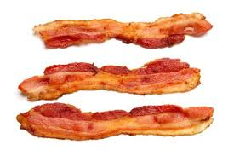
Physics of Bacon
Everything you learn is like a piece of bacon- yum
Notes:
Content Intro (2 mins. 9:05, 10:19 1:37, 2:33) Physics of Bacon:
Discuss how school is like bacon
Students are:
Following along listening, no active task

Slide 10
Physics of Bacon
History is like this:
Notes:
Content Intro (2 mins. 9:05, 10:19 1:37, 2:33) Physics of Bacon:
Discuss how school is like bacon
Students are:
Following along listening, no active task

Slide 11
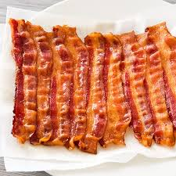
Physics of Bacon
Math is like this
Notes:
Content Intro (2 mins. 9:05, 10:19 1:37, 2:33) Physics of Bacon:
Discuss how school is like bacon
Students are:
Following along listening, no active task

Slide 12
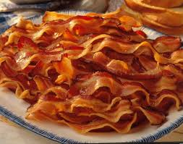
Physics of Bacon
English and Spanish are like this
Notes:
Content Intro (2 mins. 9:05, 10:19 1:37, 2:33) Physics of Bacon:
Discuss how school is like bacon
Students are:
Following along listening, no active task

Slide 13
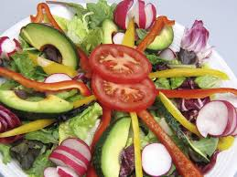
Physics of Bacon
PE is like this
Notes:
Content Intro (2 mins. 9:05, 10:19 1:37, 2:33) Physics of Bacon:
Discuss how school is like bacon
Students are:
Following along listening, no active task

Slide 14
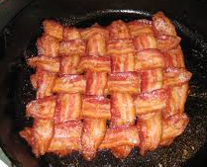
Physics of Bacon
But PHYSICS is the incredible BACON WEAVE:
Gravity
Velocity
Force
Mass
Notes:
Content Intro (2 mins. 9:05, 10:19 1:37, 2:33) Physics of Bacon:
Discuss how school is like bacon
Students are:
Following along listening, no active task

Slide 15
Calculating Acceleration with F=ma
Dir: NB’s out. Silently taking notes. Questions at the end of the slide.
2/3/15
Calculating Gravitational Acceleration
If F=ma, rewrite the equation to solve for “a”
a= F/m
Write what data you would need to collect to find an object’s acceleration:
Its Force and its mass
Notes:
Notes (4 mins. 9:07, 10:21 1:39, 2:35) Calculating Gravitational Acceleration:
Notebooks out, copying down notes
Students are:
Writing
CFU:
Visually see compliance taking notes.

Slide 16
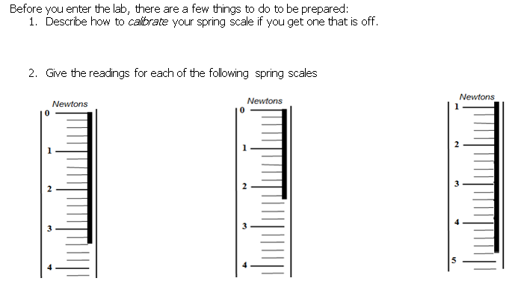
Calculating Acceleration with F=ma
Notes:
Notes (4 mins. 9:11, 10:25 1:43, 2:39) Calculating Gravitational Acceleration:
Notebooks out, copying down notes
Students are:
Writing
CFU:
Visually see compliance taking notes.

Slide 17
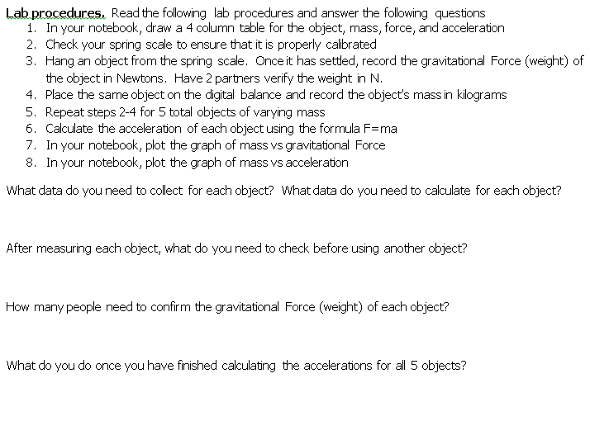
Calculating Acceleration with F=ma
Notes:
Notes (6 mins. 9:15, 10:29 1:47, 2:43) Calculating Gravitational Acceleration:
Notebooks out, copying down notes
Students are:
Writing
CFU:
Visually see compliance taking notes.

Slide 18
Calculating Acceleration with F=ma
Dir: NB’s out. Silently taking notes. Questions at the end of the slide.
Object | Mass (Kg) | Force (N) | Acceler-ation (m/s²)
Wood block
Large metal cylinder
Small metal cylinder
Bolts
Bocce ball

Slide 19
Calculating Acceleration with F=ma
15 mins: Working Quietly with group members
Notes:
Group Practice (15 mins. 9:21, 10:35 1:53, 2:49) Calculating Gravitational Acceleration:
15 min: Students are working quietly to calc.
Students are:
Working silently/independently, raising hands with questions
Aggressive Monitoring:
Correctly written problem as a top to bottom fraction.
Correctly identified which CFs to use
Correctly set up CFs with the right value on top/bottom
Units cancel
Multiplication/division makes sense
Answer is correct with proper unit
CFU’s:
Questioning during independent practice based on specifics of are they following our unit conversions process

Slide 20
CLOSING
Clean Up Time:
Binders should be pizza’ed under desks
Area should be free from trash paper
File papers as given below:
Begin working on the exit slip
Handout Title | Location
Completed Graphs in Notebooks | Notebook
Notes:
Closing and Cleanup (2 mins. 9:42, 10:38 2:14, 3:10) p=mv:
2 mins: Binders are put away and floor is cleaned up, PW is filed in red folder, desks are moved back to correct locations
Students are:
Cleaning/organizing

Slide 21
EXIT SLIP
3 mins: Complete the exit slip on the page provided
Notes:
Exit Slip (5 mins. 9:44, 10:40 2:16, 3:12) p=mv:
5 min: Students silently complete exit slip
Students are:
Writing
Aggressive Monitoring:
Score exit slips as they work and as they are leaving

