Slide 1
Physics Lesson Plan
Unit 11-Electrostatics
Scientific Notation
Fri 5/13/2016
A guided practice lesson by
T.M. Wackerman
Notes:
Objective: Students will be able to… Explain the concepts force and equilibrium
Assessment: By…
Handing in 2 page packet
Key Points:
KP1: Force is a push or pull
KP2: Net force is the total force acting on an object
KP3: When all the forces balance, an object will be in a steady state (not moving). This is called equilibrium
KP4: In equilibrium, net force = 0 Newtons (ƩF=0N)
Key Terms/Vocabulary:
See slide 9

Slide 2
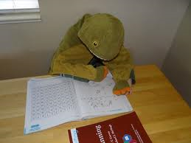
FRONT OF ROOM 1st PERIOD
Princess | Maurice | Tyrese | Chrissy | Khamiyah | Shaq
 |  | Yayah | Rowan | Maia | Jordan
Kayla | Gabby | Ashley | Vincent | Mikey | Jermain
ONE MINUTE
FIVE MINS | Complete the Do Now.
PW 12.02
12.03
Do Now
Under Seat:
Notes:
Please check that students actually have materials out, as they will need them for class

Slide 3
FRONT OF ROOM 2nd PERIOD
Lindslay | Curt | Daquan | Denzel | Ama | Tiffany B
Darius | Tiffany D | Jayda | Jazzy | Richie
 |  | Gabby | Ginise | Charna | Kaelah
ONE MINUTE
FIVE MINS | Complete the Do Now.
PW
12.02
12.03
Do Now
Under Seat:
Notes:
Please check that students actually have materials out, as they will need them for class

Slide 4
FRONT OF ROOM 4th PERIOD
Dallin | Koule | Renaud | Jahiem | Jordy | Carrington
Mary | Jasmine | Raquon | Aamour | Roslyn | Christoff
AJ | Khalique | Imani | Allan | Daniel | Nafi
Wendel | Deanna | Norman | Samiah | Elaisia | Storm
 |  | Rae | Rey
ONE MINUTE
FIVE MINS | Complete the Do Now.
PW
12.02
12.03
Do Now
Under Seat:
Notes:
Please check that students actually have materials out, as they will need them for class

Slide 5
FRONT OF ROOM 5th PERIOD
Zahmair | Jamal | Devonne | Demarre | KJ | Nicole
Liam | Jensine | Kane | Trinide | Brandon | Kyrstan
Eli | Ray | Emmanuel | Karim | Alonzo | Max
Cyprene | Nuh |  | Jahiem | Kavaughn | Jayda
ONE MINUTE
FIVE MINS | Complete the Do Now.
PW 12.02
12.03
Do Now
Under Seat:
Notes:
Please check that students actually have materials out, as they will need them for class

Slide 6
TODAY’S OVERVIEW
Announcements:
Progress Reports Friday will include all retested objectives and late work
Friday is your final Physics Quiz
Topics from today’s class
Conservation of Momentum Full
Vocab
Optional Retest
Charge Interactions if <6/8
Charge Induction if <7/10
Notes:
Say “You will know if you have mastered today’s lesson if at the end of class you can explain and apply the ideas of force and equilibrium

Slide 7
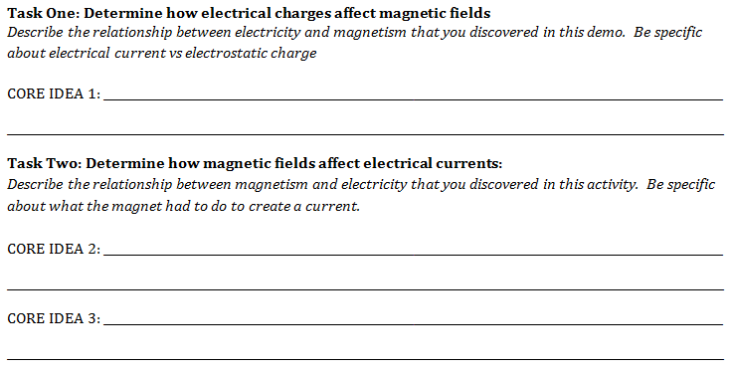
CORE IDEAS AND SUMMARY
A moving charge (current) will create a magnetic field. Electrostatic charge will not
A magnetic field moving through a circuit will create a current
The direction/pole of the magnet affects the direction the current will flow
Notes:
Read this slide and put timer for 10 minutes.
Not all students may finish in this time, that is okay, there will be time later.
If students finish early, have them read “personal essay on page 15”

Slide 8
CORE IDEAS AND SUMMARY
Electricity and magnetism are two separate but connected parts of the same force- the electromagnetic force
Homework and quizzes are two separate but connected parts of the same thing-
your final grade
Notes:
Read this slide and put timer for 10 minutes.
Not all students may finish in this time, that is okay, there will be time later.
If students finish early, have them read “personal essay on page 15”

Slide 9
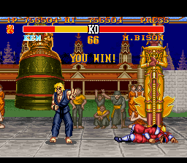
CLOSING OUT
Clean Up Time:
File papers as shown below
Area should be free
from trash paper
Seats are pushed in
and rows are in line
Handout Title | Location
Today’s Packet | Binder: Classwork
Exit Slip | Handed in
Prepwork 7.06- Conceptual Momentum | Red Folder
Notes:
Put up final slide!
Thanks for your help, friend!!

