Slide 1
Adiabatic Boiling via Pressure Drop
STEM Lab Library Experiment

Slide 2
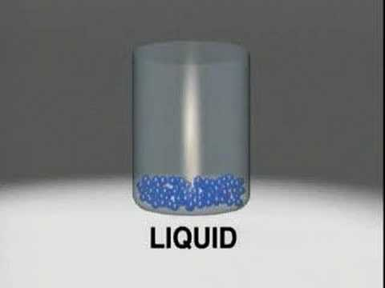
States of Matter
Review
Notes:
Video URL: https://youtu.be/WOEvvHbc240

Slide 3
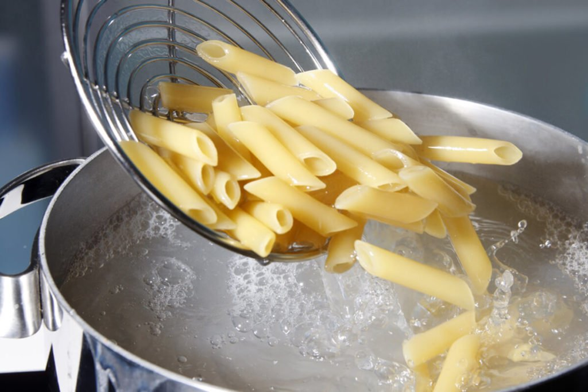
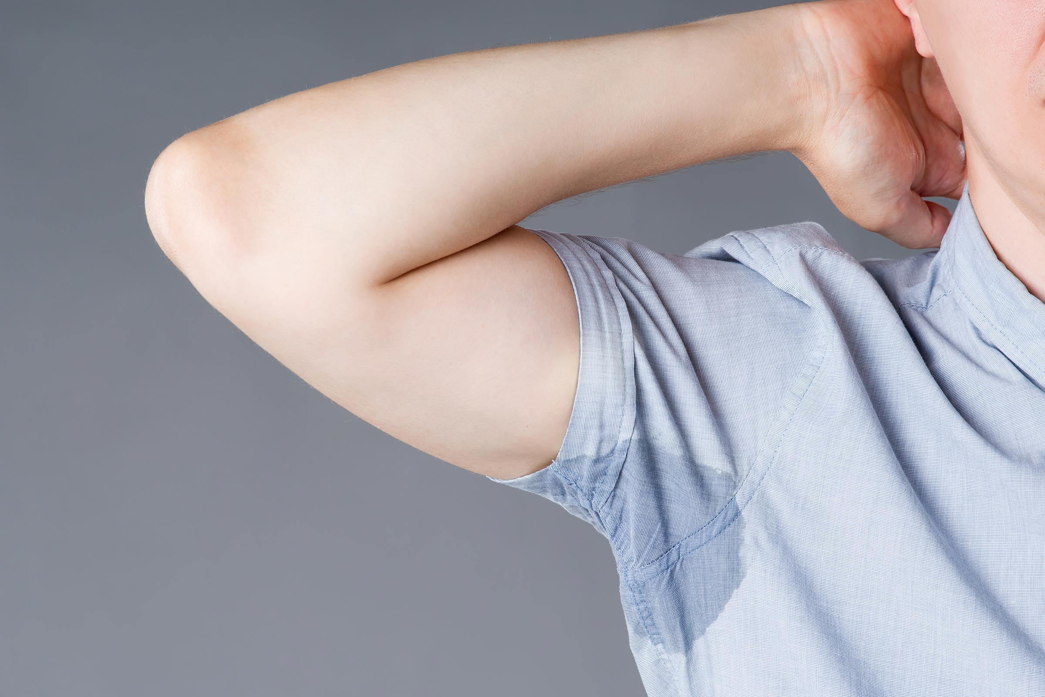
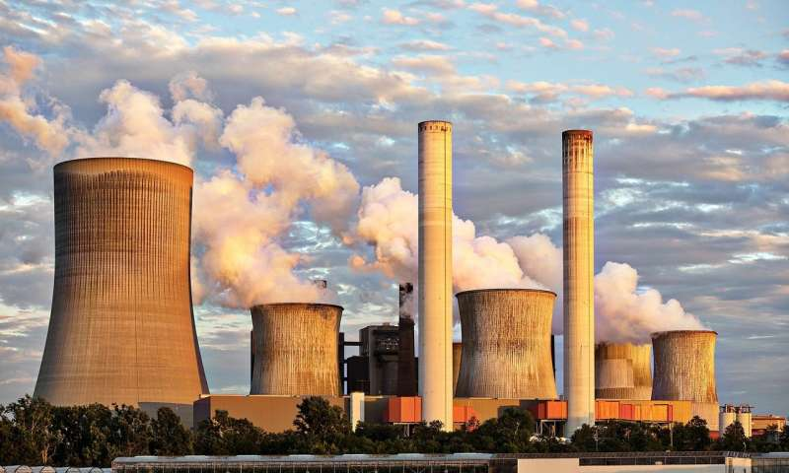
What is boiling?
Review
Boiling is what occurs when a liquid rapidly transitions into a gas
The general term for this transition is vaporization
Examples include: Boiling and evaporation
Applications of vaporization
Cooking
Boiling water is key for cooking many foods, such as pasta or eggs
Perspiration (sweating)
Human beings sweat in order to cool off
Energy (turbines)
One of the main sources of energy on the planet is boiling water and allowing the steam created to turn turbines and generate electricity

Slide 4
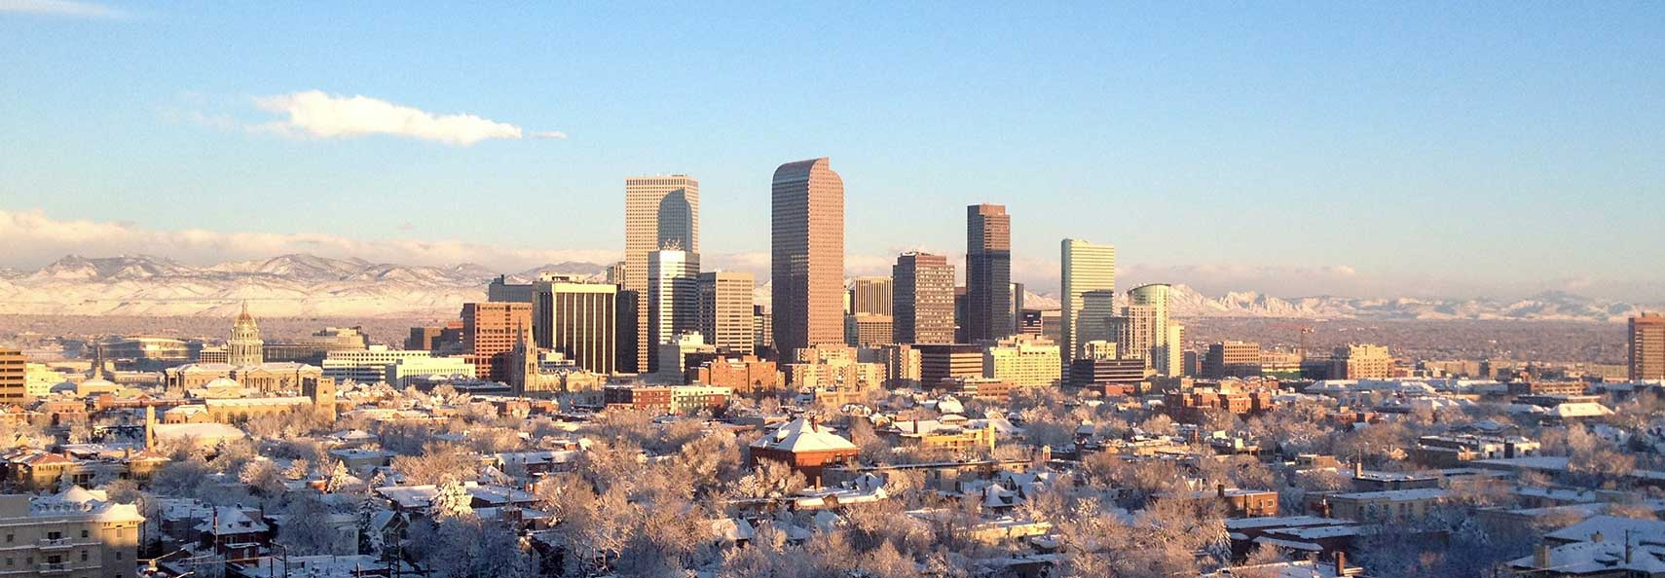
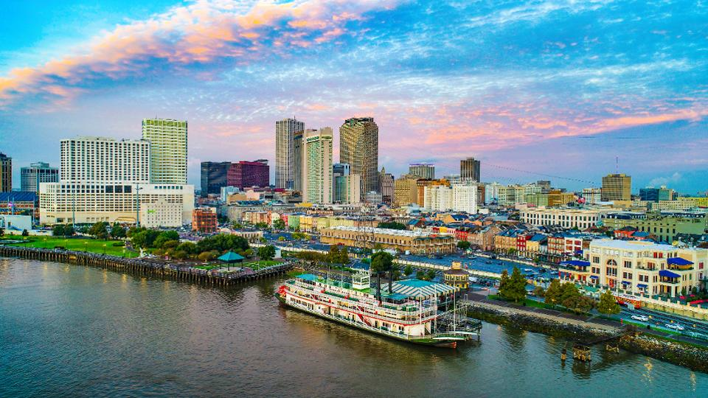
Boiling point
The boiling point temperature/pressure is the temperature/pressure at which boiling occurs for a given liquid substance
For example, water boils at around 212 °F/100 °C, while ethanol boils at 173 °F/ 78 °C
Why? See next slide for more detail
One important thing to remember is that boiling is not only a function of temperature, it is a function of pressure as well.
For example, the boiling point of water near sea level (New Orleans) is around 100 °C, but the boiling point of water at the peak of Mount Everest is 160 °F/ 71 °C.
This is because the atmosphere is lower pressure the higher you go
Q: Would water in Denver, Colorado boil at a lower or higher temperature than water in New Orleans, LA.

Slide 5
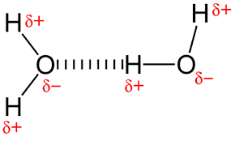
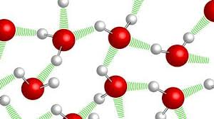
Intermolecular forces: Hydrogen Bonding
Hydrogen bonding
Hydrogen bonding occurs when you have a bond between an electron loving atom (such as oxygen), and an electron hating one (such as hydrogen)
Other Intermolecular forces (IMFs)
Ionic bonds
Stronger attractive forces due to complete charges between atoms in a bond
Na+ ------- Cl-
Van der Waals forces
Weak temporary attractive forces

Slide 6
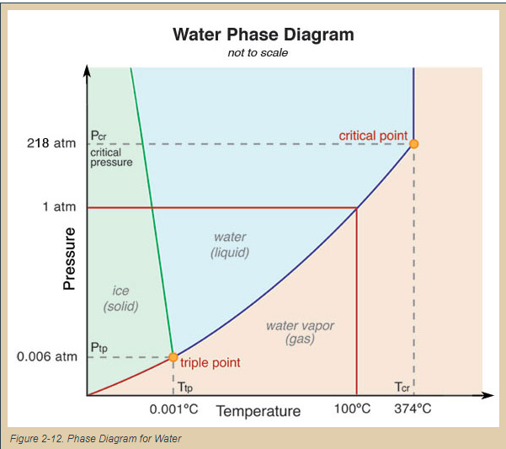
Water Phase Diagram
Critical Point
Point at which liquid and gas become indistinguishable
Triple Point
Point at which all three phases of matter can coexist

Slide 7
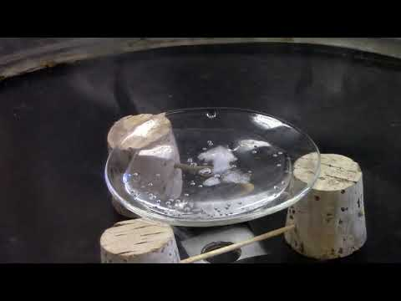
Triple Point Video

Slide 8
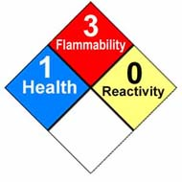
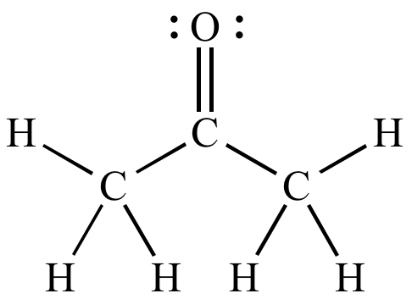
What is Acetone?
Acetone is a colorless, volatile, flammable liquid, and is the simplest and smallest ketone
Nail polish remover is ~50% acetone
Experiment Time!!!

Slide 9
Kinetics of Phase Change
What’s really going on?
Notes:
Video URL: https://youtu.be/WOEvvHbc240

Slide 10
Resources & Links
https://en.wikipedia.org/wiki/Boiling_point
https://www.youtube.com/watch?v=s-KvoVzukHo
https://www.youtube.com/watch?v=Juz9pVVsmQQ
https://en.wikipedia.org/wiki/Acetone

